Slide 1

Women in Politics
PRESENTED BY Nu Wai Thet (mmdt2024.001) and Khine Zar Lwin mmdt2024.037

Slide 2

Content
Dataset limitation understanding
Improvement suggestions for Limitations
Understanding and finding the relationship of numerical/categorical features and women representation in parliament
Finding Insights and underlying patterns for overall demographic and women representation
Trend Analysis
Finding which features most contributed to women representations
Clustering analysis with Kmeans
Summary and Conclusions

Slide 3
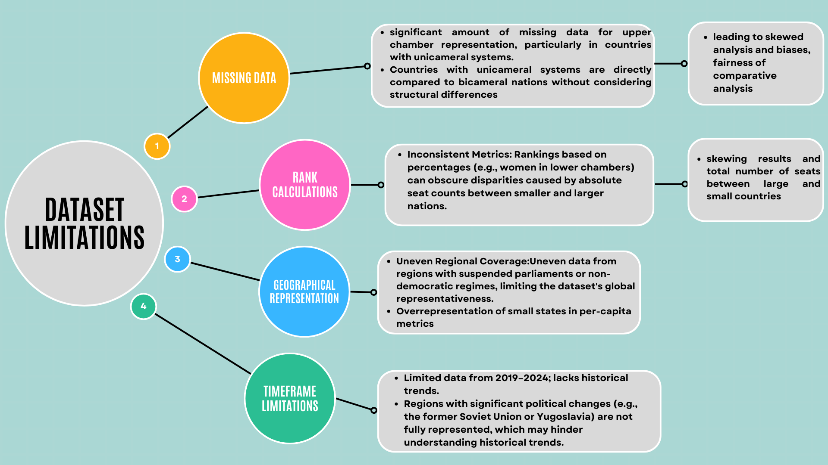

Slide 4
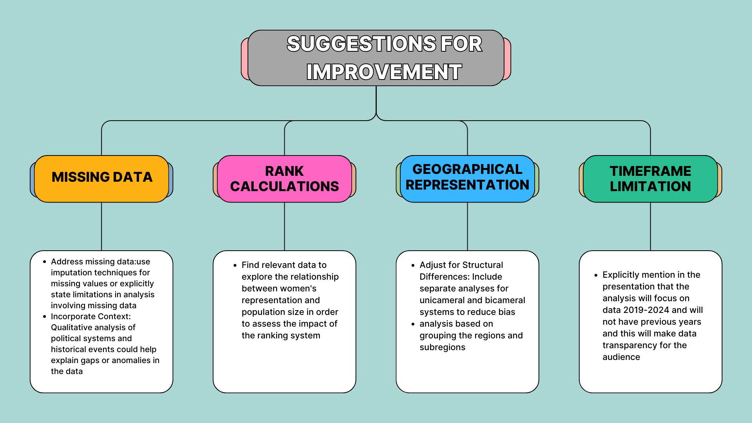

Slide 5
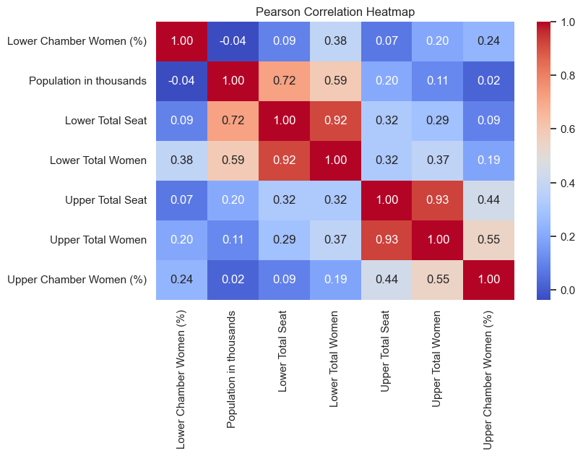
Do numerical features, such as population size and total seats, significantly impact women's representation in parliament?
Population Size Does Not Bias Representation– The correlation of population size with women’s representation is very low (-0.04 for the lower chamber and 0.02 for the upper chamber), indicating that population size does not strongly influence representation.
Weak Impact of Total Seats – The total number of seats in both chambers also shows weak correlation with the percentage of women (0.09 for lower chamber and 0.09 for upper chamber), meaning that larger parliaments do not necessarily lead to higher representation.
Weak Linear Relationships Across Features – The correlation heatmap shows that no numerical feature strongly predicts women's representation in either the lower or upper chamber. Lower Chamber Women (%) vs. Lower Total Seats → 0.09 (weak correlation)
Upper Chamber Women (%) vs. Upper Total Seats → 0.09 (weak correlation)
We have done polynomial regression fit to cross check whether there are non-linear relationship between population size Vs women representation. And found out that polynomial regression fit of population size vs. women’s representation shows that the polynomial fit line is nearly flat, suggesting no systematic bias between small and large parliaments.

Slide 6
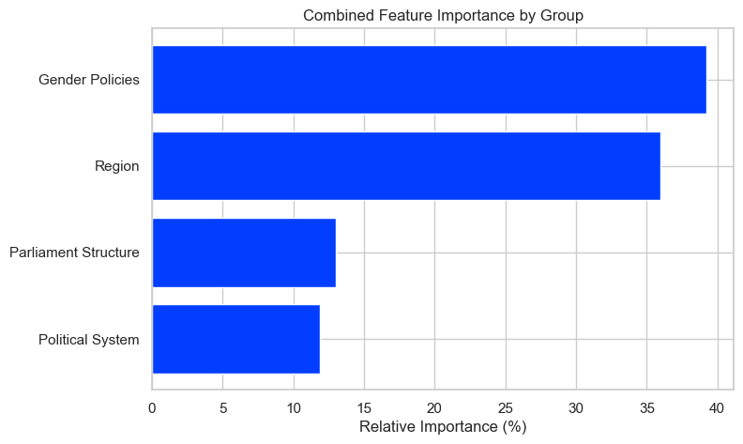
Which categorical features have the most impact on women's representation in parliament?
Gender Quotas are the strongest predictor – Countries that implement gender quotas have significantly higher women's representation in parliament
Regional differences play a key role – European countries show the highest influence, while other regions, such as Sub-Saharan Africa and the Middle East, also impact representation.
Parliamentary structure and political system matter – Unicameral parliaments tend to have higher women's participation. Additionally, presidential and mixed political systems have a notable effect.
Gender equality policies contribute – Countries with explicit gender equality measures show a positive correlation with women's participation in parliament.

Slide 7
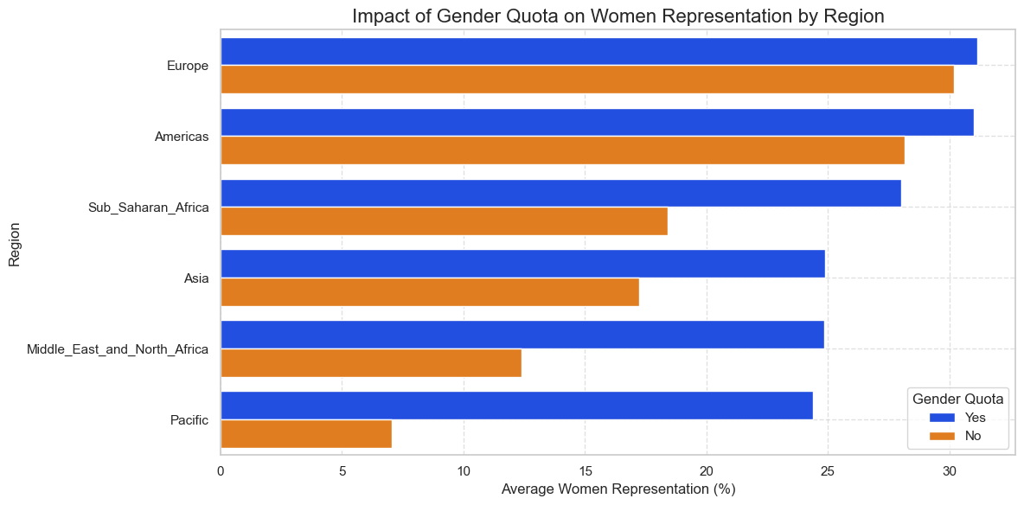
How does the presence of a gender quota impact women's representation in parliament across different regions?
In all regions, having a gender quota leads to higher women's representation in parliament.
In all regions, having a gender quota leads to higher women's representation in parliament.
The impact of gender quotas is particularly significant in regions like the middle East and North Africa and Sub-Saharan Africa, where the difference in representation is quite noticeable.
The impact of gender quotas is particularly significant in regions like the middle East and North Africa and Sub-Saharan Africa, where the difference in representation is quite noticeable.
Even in regions with relatively high representation, such as Europe and the Americas, gender quotas still contribute to a measurable increase in women's participation.
The Pacific region has the lowest women's representation without gender quotas, suggesting that quotas could play a crucial role in improving inclusivity..

Slide 8
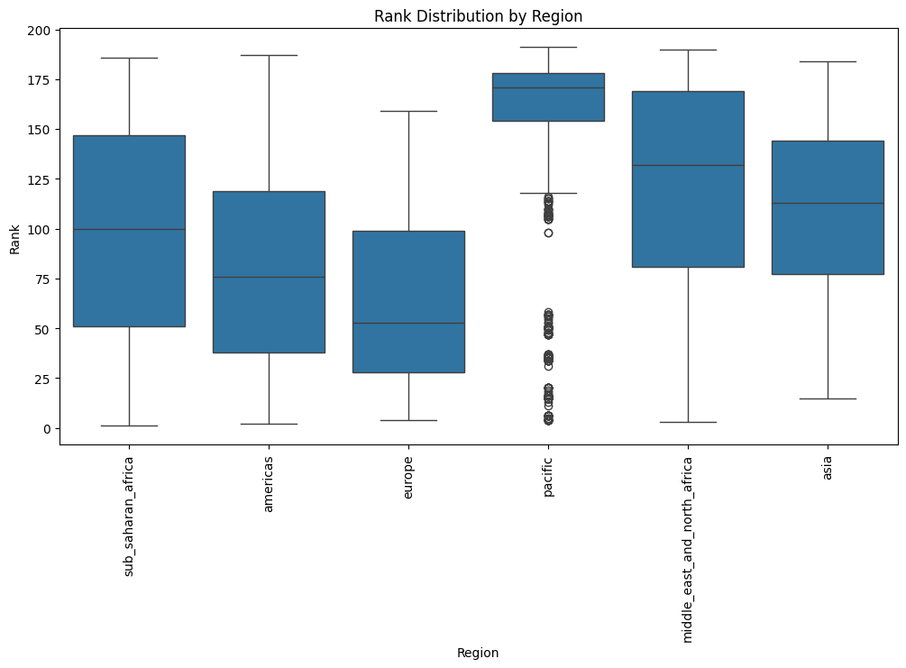
How does the distribution of rankings for women’s participation in parliament vary across different regions?
Findings
Europe & Americas have a lower median rank, indicating better overall performance.
Pacific & Middle East/North Africa have a higher median rank, suggesting weaker rankings overall.
Europe has the smallest IQR, meaning rankings are more consistent.
Pacific has the widest range with many outliers, showing high variability in rankings.
Outliers are most frequent in the Pacific region, indicating exceptional cases of very high or low rankings.
Median is used instead of mean because it is less affected by extreme values and better represents typical ranking

Slide 9
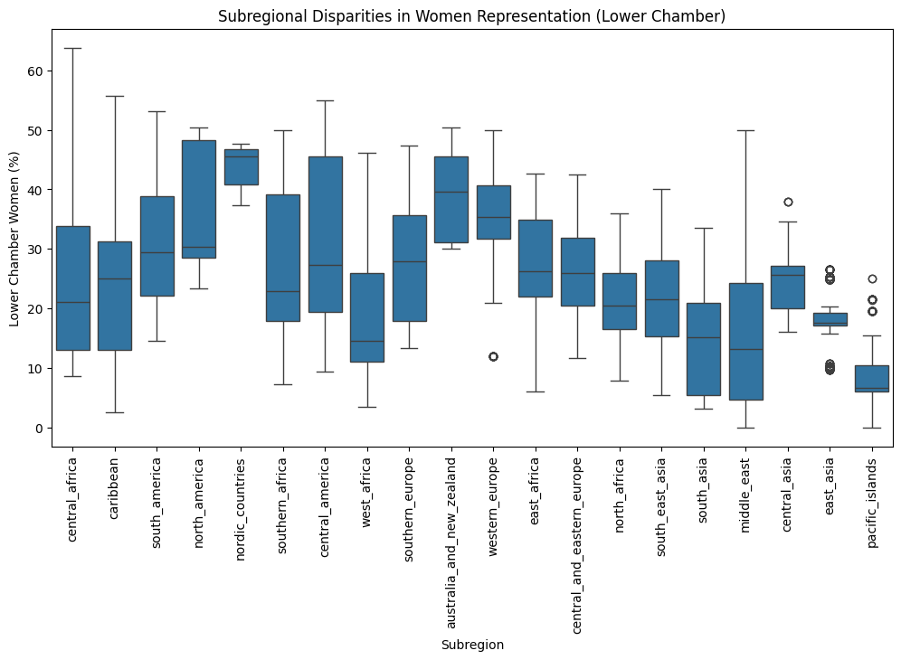
How does women's representation in lower chambers vary across different subregions?
Findings
Highest Representation: Nordic Countries, Australia & New Zealand, and Western Europe (40-50% women in lower chambers).
Moderate Representation: Southern Africa, South America, and Caribbean (30-40%).
Low Representation: Central Asia, Middle East, East Asia, and Pacific Islands (below 20%).
Wide Variability: Central and West Africa show large disparities within their subregions.
Outliers: Some regions, like East Asia and Pacific Islands, have extreme cases of low representation.

Slide 10
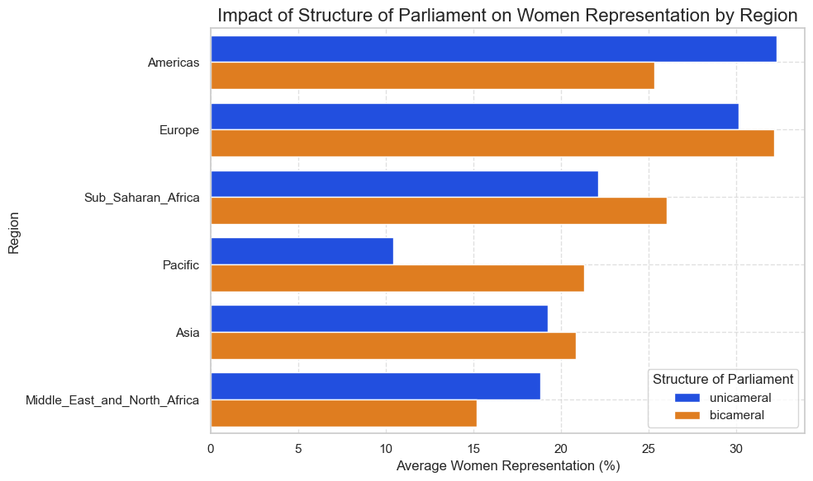
Does the structure of parliament (unicameral vs. bicameral) impact women's representation in parliament across different regions?
Findings:
Across most regions, bicameral parliaments tend to have a slightly higher percentage of women in the lower chamber compared to unicameral parliaments
This trend is evident in regions like Europe, Sub-Saharan Africa, and Asia, where bicameral systems show noticeably higher female representation.
Statistical Analysis:
A T-test was conducted to check if the difference in women's representation between bicameral and unicameral parliaments is statistically significant.
The results showed a t-statistic of 6.28 and a p-value of 3.39e-10, which indicates a highly significant difference between the two groups.
The standard deviations for both systems are relatively similar (bicameral: 12.41, unicameral: 12.69), suggesting that there is variability in representation within both structures.
Conclusion:
The structure of parliament does have a significant impact on women's representation.
Bicameral parliaments generally foster greater women's representation, which could be due to institutional factors, additional legislative checks, or greater political inclusivity in such systems.
However, regional variations exist, and further analysis could explore whether specific policies within these structures influence the observed differences.

Slide 11
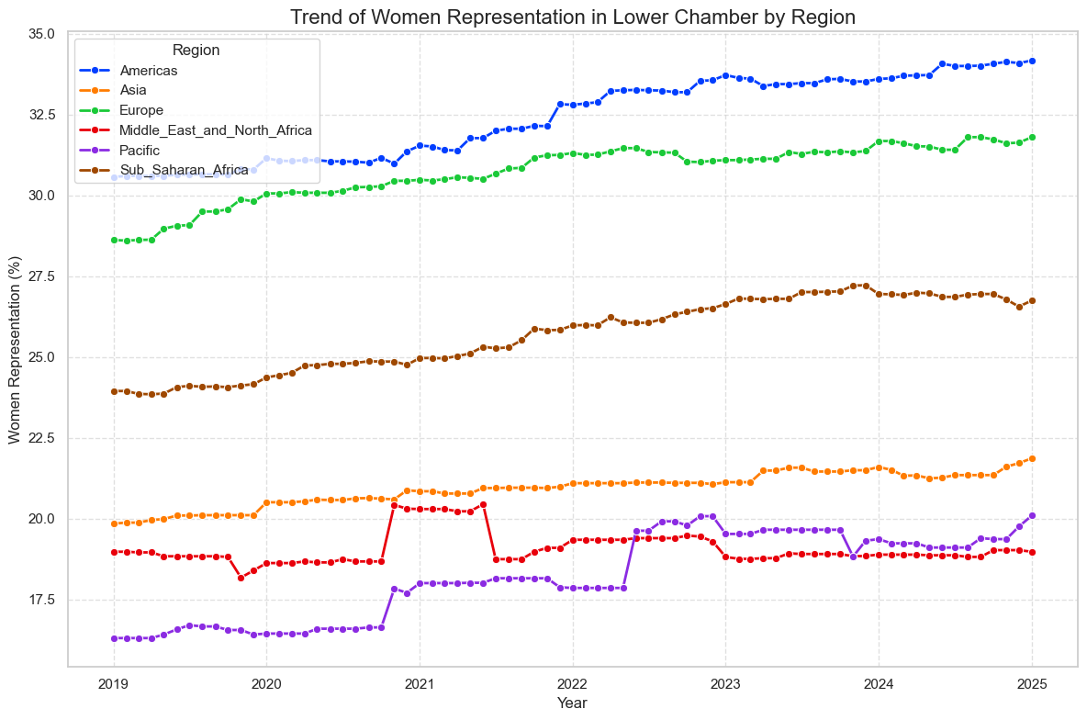
How has women's representation in the lower chamber of parliament changed over time across different regions?
Finding:
While all regions show some level of improvement, the rate of progress varies.
Americas and Europe lead in women's parliamentary representation, while Middle East, North Africa, and the Pacific lag behind.
These trends could be influenced by regional policies, gender quotas, and political reforms.

Slide 12
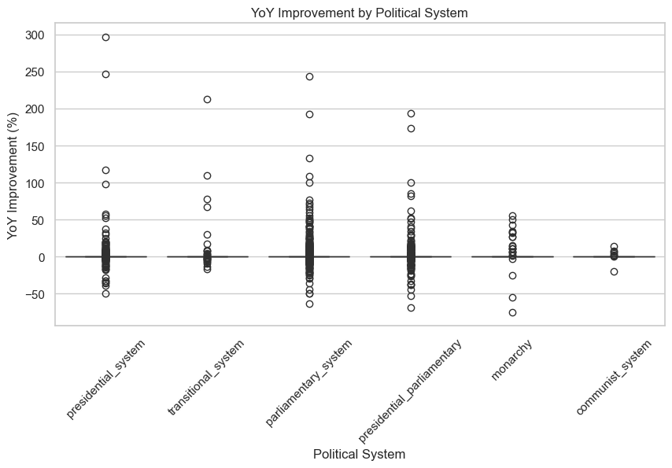
How does the political system impact the Year-on-Year (YoY) improvement in women's participation in parliament?
The analysis of Year-on-Year (YoY) improvement in women's participation in parliament across different political systems reveals that governance structures may play a role in shaping progress. While some political systems, particularly presidential and parliamentary systems, show greater fluctuations and instances of significant improvement, others, such as monarchies and communist systems, tend to exhibit more stability with limited variation.
The presence of outliers suggests that certain countries have made substantial gains in particular years, possibly due to policy changes, electoral reforms, or quota implementations. However, the overall trend indicates that progress is gradual and varies widely between political systems.

Slide 13
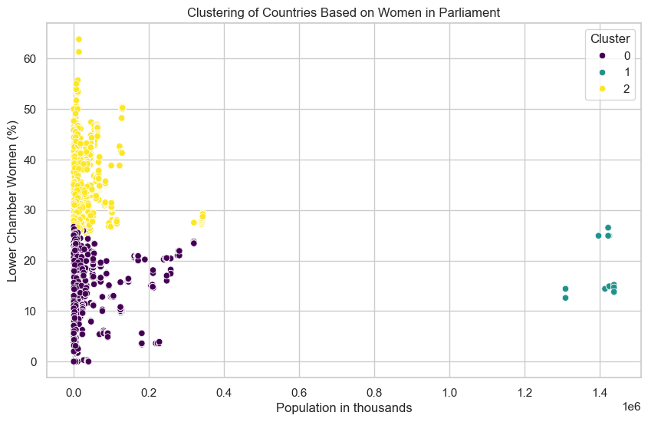
Gender Representation in Parliaments: A Clustering Analysis(Kmeans)
How do countries cluster based on women's representation in parliament and population size?
Findings
Cluster 0 (Dark Purple) – Low Representation, Small Population
Countries have low female representation (<30%) in parliament.
Mostly small nations (<400,000 population).
Likely due to lack of gender quotas or cultural barriers.
Cluster 1 (Teal) – Moderate Representation, Large Population
Countries have moderate female representation (15-30%).
High-population countries (>1 million), including large economies.
Likely face systemic challenges in gender equality policies.
Cluster 2 (Yellow) – High Representation, Mixed Population
Countries have high female representation (>30-60%).
Mostly small to mid-sized populations, with some outliers.
Likely benefit from strong gender policies & quotas.

Slide 14
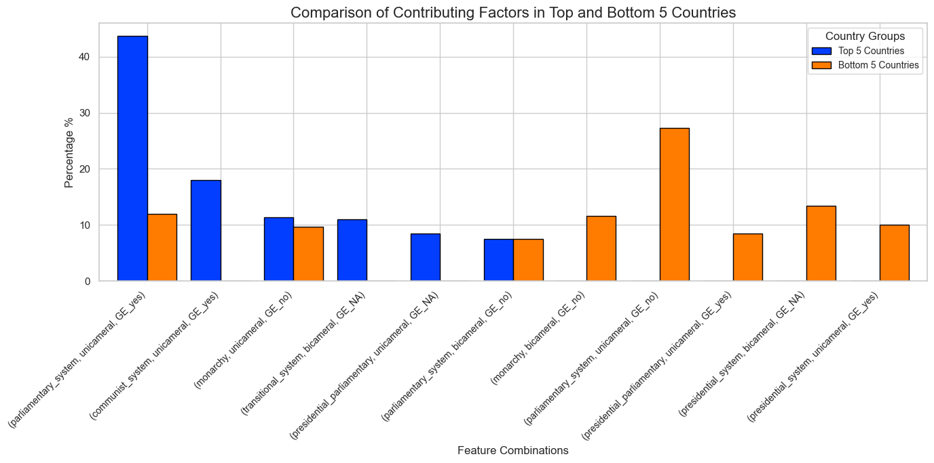
What factors most significantly influence women's representation in the top and bottom 5 countries?
Findings
The percentage of women in parliamentary representation varies significantly across countries due to a combination of political systems, legislative structures, and the presence (or absence) of gender equality measures.
Key Drivers of Improvement: Countries with unicameral legislatures, parliamentary or communist systems, and explicit gender equality policies tend to show the most significant progress.
Challenges in Low-Performing Countries: A lack of gender equality measures, coupled with certain governance structures like bicameral legislatures, hinders progress in increasing women's representation.

Slide 15
Summary and Conclusions
This analysis underscores the need for continued policy efforts, institutional support, and legislative reforms to drive a more consistent and substantial increase in women's representation in parliament across different governance models.
While no single factor solely determines women’s representation, a combination of gender policies, political systems, human rights, and equality measures plays a crucial role. Additionally, cultural, economic, and broader policy-related factors may have an even greater impact than political systems alone.
Despite progress, women's participation in parliament remains uneven. Institutional reforms, gender quotas, electoral policies, and political structures significantly influence inclusivity. Future efforts should prioritize policy-driven interventions to ensure sustained and equitable representation worldwide.

Slide 16
Thank you

Slide 17
Supporting data

Slide 18
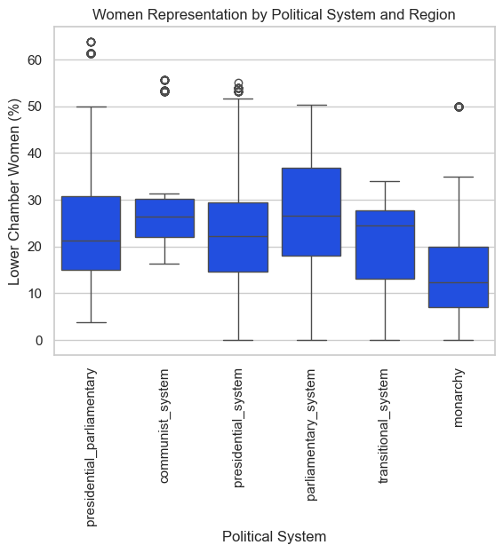
How does the political system impact women's representation in parliament across two parliament structure?
Findings:
Highest Representation: Countries with a communist system have the highest average percentage of women in the lower chamber (12.69%).
Lowest Representation: Countries with a transitional system have the lowest average percentage of women (10.08%).
Other political systems (monarchy, parliamentary, presidential-parliamentary, and presidential) cluster around a similar range, between 11.87% and 12.55%.
Range of Values:
The values do not show extreme variation; the highest is 12.69%, and the lowest is 10.08%. This indicates that the political system might not have a large effect on the percentage of women in the lower chamber.
While the communist system seems to have slightly better representation of women in the lower chamber compared to other systems, the difference across systems is relatively small. Other factors beyond political systems (e.g., cultural, economic, or policy-related factors) might play a more significant role in determining women's representation.

Slide 19
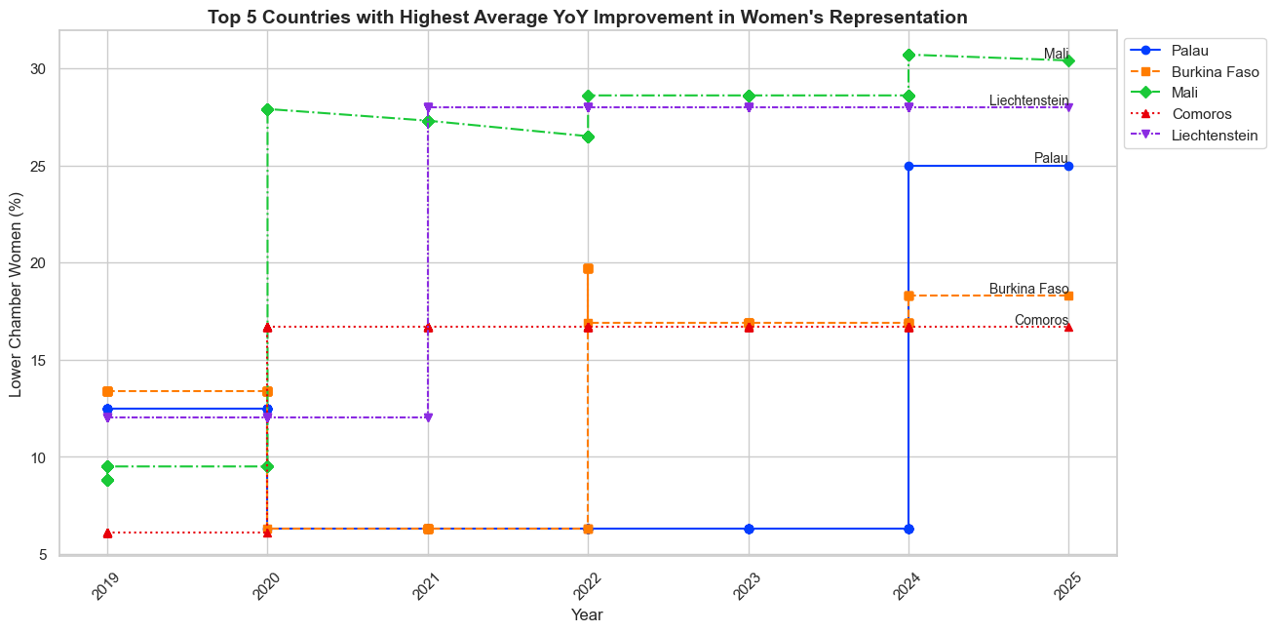
Which countries have demonstrated the most significant improvement in women's representation in parliament over recent years?
Findings:
Top Performers: Countries like Mali, Liechtenstein, and Burkina Faso stand out for their consistent improvement in the percentage of women in their lower chambers of parliament.
Mali: Experienced the highest YoY increase, achieving over 30% representation by 2025.
Palau: Shows a steady but relatively modest increase, maintaining progress over the years.
Comoros and Burkina Faso: Demonstrated more gradual improvements, with notable jumps in specific years.
Overall Trend: A positive shift is evident, though the pace and scale vary significantly between countries.

Slide 20
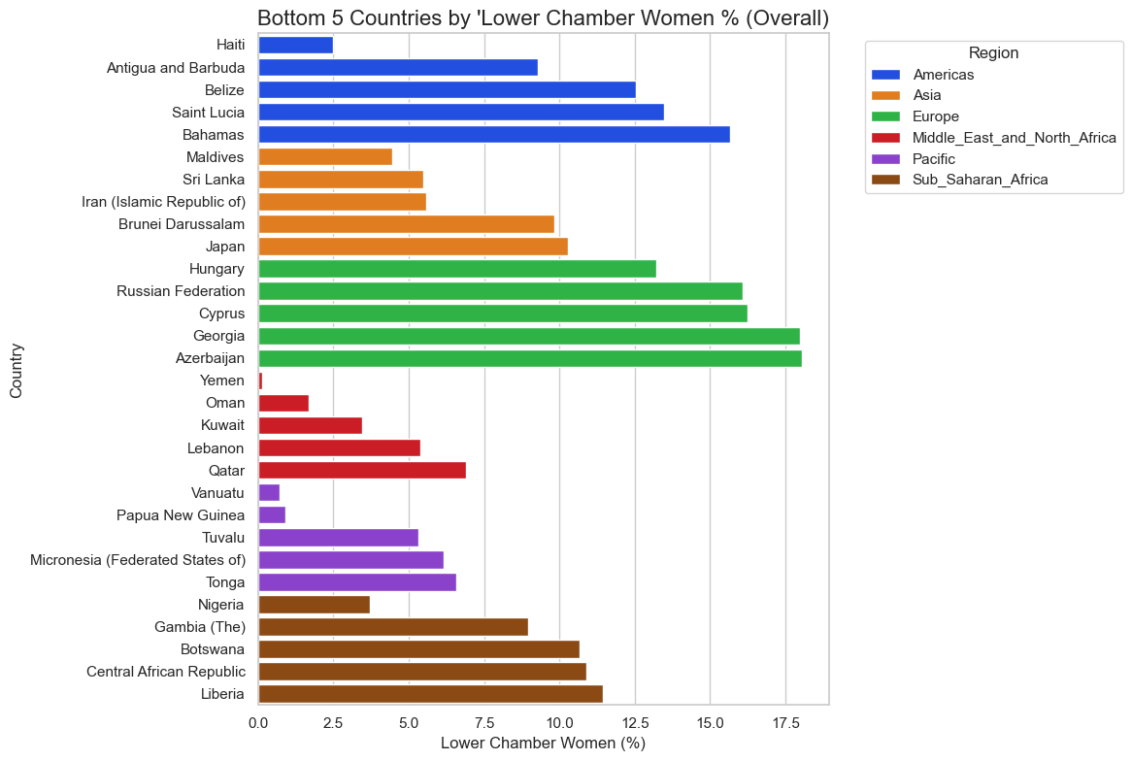
Top 5 countries List

Slide 21
Bottom 5 countries List

